Slide 1
Week 2: Inferential Statistics 1 (T-test)
Prof. Ah-Lian Kor
A.Kor@leedsbeckett.ac.uk

Slide 2
Categories of Statistical Tests
Parametric tests – assumptions (normal distribution; homogeneity in terms of variances)
Non-parametric tests
More Discussion
Testing assumptions http://www.statisticssolutions.com/testing-of-assumptions/
https://www.healthknowledge.org.uk/public-health-textbook/research-methods/1b-statistical-methods/parametric-nonparametric-tests
http://blog.minitab.com/blog/adventures-in-statistics-2/choosing-between-a-nonparametric-test-and-a-parametric-test
http://www.real-statistics.com/descriptive-statistics/assumptions-statistical-test/

Slide 3
Week 2: Level 2 Inferential Statistics
Inferential Statistics:
T-test – Week 2
ANOVA – Week 2
Correlation - Week 3
Pearson Chi-square – Week 3

Slide 4
T-tests
Types of T-tests
One-sample test (only a single sample)
Paired test (one sample with 2 measures or two-matched samples with 1 measure)
Two-sample test (two samples)

Slide 5
One-sample t-tests
An example – if we have a cars dataset with 1 column on horsepower (hp)
Question to answer (Go to Options Tab):
We would like to answer the following research question:
Is the average horsepower significantly different from 300?
We shall conduct a 2-tailed test
Confidence level (95%) or level of significance (α = 0.05)
P-value is the calculated probability to be compared with α
We would like to test the following hypotheses
Null hypothesis: H_{o} : µ = 300;
Alternative hypothesis: H₁ : µ ≠ 300;

Slide 6
Rule for accepting or rejecting a null hypothesis (i.e. reject or accept the alternative hypothesis)
If p-value is less than or equal to α (single tail) test; α/2(two-tailed test), then reject the null hypothesis in favour of the alternative hypothesis
If p-value is greater than α (single tail test); α/2(two-tailed test), then accept the null hypothesis and reject the alternative hypothesis

Slide 7
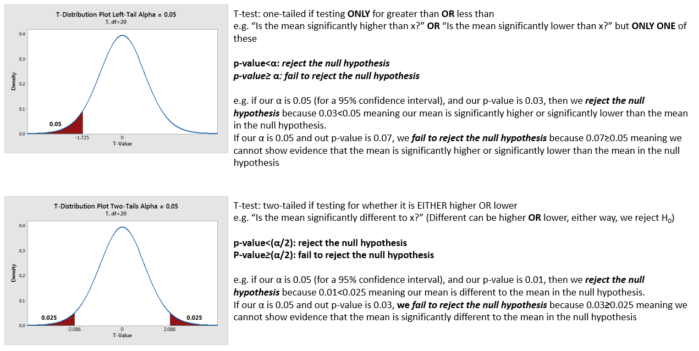
More explanation of t-test

Slide 8
One-Sample t-test
Look at Self Paced Tutorials, number 7 for one-sample t-test where you compare the verbal IQ (VIQ) of the sample to a population mean of 0.
The research question is:
Is the VIQ mean of the sample significantly different from the population mean of 0?
We shall choose a two-tail test
You need to test the following hypotheses
Null Hypothesis (H₀): mean of VIQ = 0;
Alternative Hypothesis (H_{a}): mean of VIQ ≠ 0
Choose: Confidence Level (95%) or alpha value, α = 0.05
The results of the test and interpretation is found in Example 1.1, page 5 of the Self Paced Tutorials

Slide 9
Two-sample T test
For example, we have two samples:
Group 1 – Female
Group 2 – Male
Variable – Height
Research Question: Is there a significant difference in the mean height for male and female?
Confidence level – 95%
Null hypothesis: H_{o} : µ₁ = µ₂ or µ₁ - µ₂ = 0;
Alternative hypothesis: H₁ : µ₁ ≠ µ₂ or µ₁ - µ₂ ≠ 0;

Slide 10
Two-Sample T-Tests
T-test: Two-sample test
Look at Self Paced Tutorials, examples on pages 6-9

Slide 11
Summary of Two Sample t-test
Checking assumptions
Two sample t-test assumes that
There is one continuous dependent variable and one categorical independent variable (with 2 levels);
The two samples are independent;
The two samples follow normal distributions, and can be done with Normality check.
When the assumptions are not met, other methods are possible based on the two samples:
Two dependent samples and follow Normal distribution, suggest Paired T-test;
Two independent samples and does not follow Normal distribution, suggest WMW test;
Two dependent samples and does not follow Normal distribution, suggest Signed Rank test;
In this demo example, two samples (control and treatment) are independent, and pass the Normality check. So we continue with two sample t-test. Note that the test is two-sided (sides=2), the significance level is 0.05, and the test is to compare the difference between two means (mu1 - mu2) against 0 (h0=0).
http://www.stat.purdue.edu/~tqin/system101/method/method_two_t_sas.htm

Slide 12
Resources
One-sample t test and test for normality https://www.youtube.com/watch?v=UsbDpmUQG9g
Paired and Two-Sample t tests
https://www.youtube.com/watch?v=ULq9kQtIDMQ https://support.sas.com/training/tutorial/studio/two-sample-t-test.html http://www.stat.purdue.edu/~tqin/system101/method/method_two_t_sas.htm
Chi Square https://www.youtube.com/watch?v=ULq9kQtIDMQ
Parametric and non-parametric correlation
https://www.youtube.com/watch?v=wuzYb-79TfM
http://video.sas.com/detail/videos/how-to-tutorials/video/3306921462001/correlation-analysis-using-sas-studio

Slide 13
Resources
A diverse range of inferential statistical analysis http://video.sas.com/detail/videos/performing-statistical-analyses/video/3306921462001/correlation-analysis-using-sas-studio?autoStart=true
Pearson Correlation and Procedures http://libguides.library.kent.edu/SAS/PearsonCorr

